Slide 1
Neural Style Transfer
CS517 Mini Project
Paras Goyal 2018CSB1111
Sakshay Mahna 2018CSB1119

Slide 2
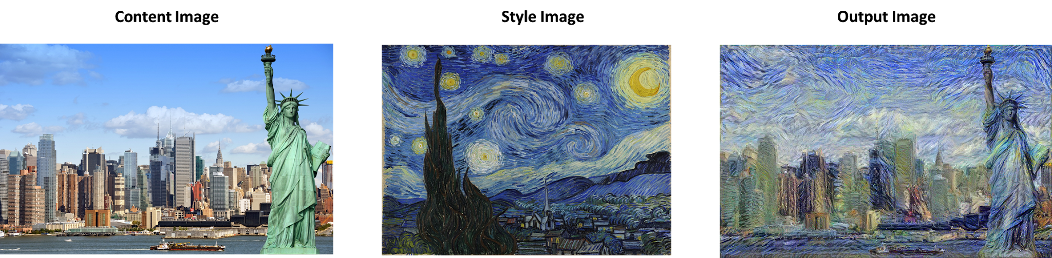
The problem
Neural style transfer is an optimization technique used to take two images—a content image and a style reference image (such as an artwork by a famous painter)—and blend them together so the output image looks like the content image, but “painted” in the style of the style reference image.

Slide 3
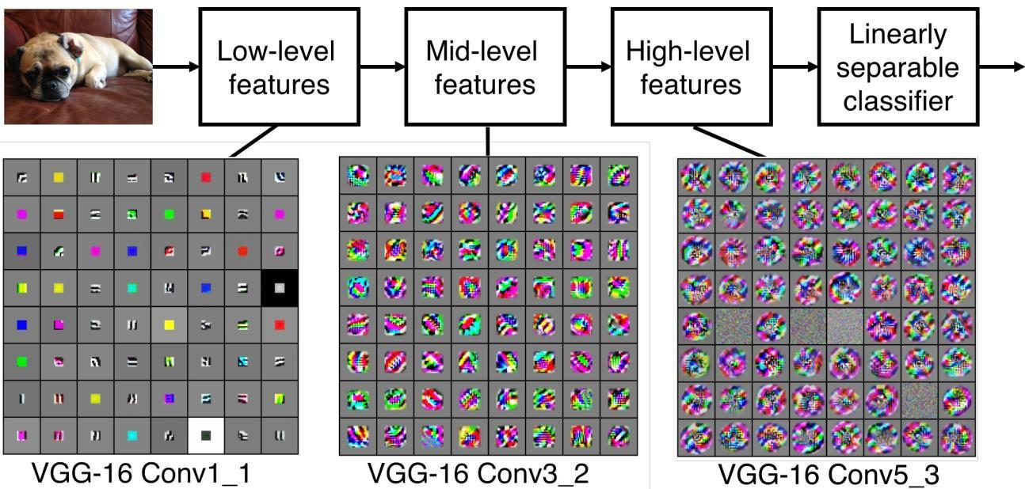
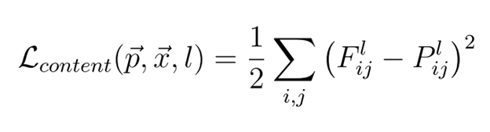
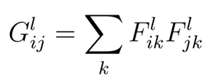
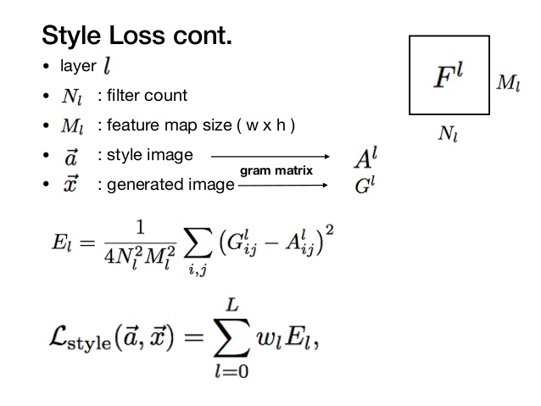
Previous work
Various methods have been used to approach the problem. All are based on the fact that in a deep CNN such as VGG16 The lower layers specialize in detecting low level features such as line and edges, whereas the high level features such as objects shapes are detected by layers deeper in the network. Therefore it can considered the deeper layers capture the content of the image whereas shallower layers combined with deeper layers capture the overall style of the image. We generate style in terms of correlation between different filter outputs of a CNN layer. This fundamental idea was first highlighted and implemented by the following paper A Neural Algorithm for artistic style. (Gatys et al. 2016). The approach though insightful is not practical for implementation as it takes a lot of time and computation. Also it is not feasible to store a complete VGG model on mobile devices.

Slide 4
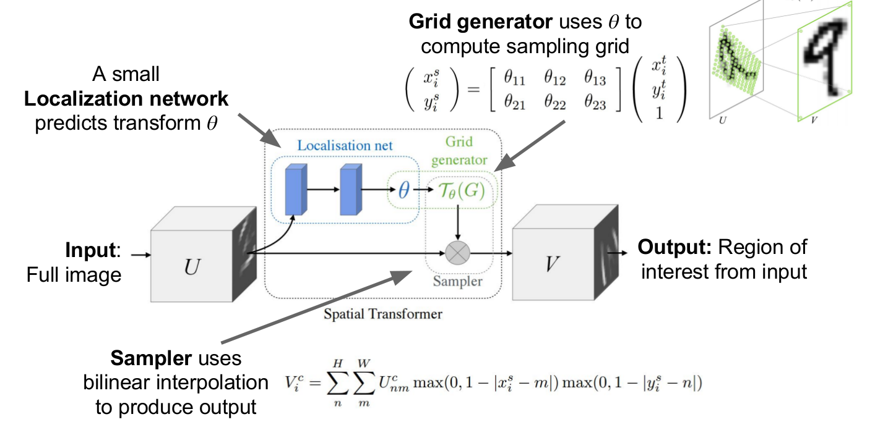
Previous work
The next breakthrough was to train a feedforward convolutional neural network in a supervised manner, using a per-pixel loss function to measure the difference between output and ground-truth images. Such approaches are efficient at test-time, requiring only a forward pass through the trained network. However, the per-pixel losses used by these methods do not capture perceptual differences between output and ground-truth images. But, high-quality images can also be generated using perceptual loss functions based on differences between high-level image feature representations extracted from pretrained convolutional neural networks. These approaches produce high-quality images, but are slow since inference requires solving an optimization problem. This is highlighted in this paper (Johnson et al 2016) Perceptual loss for real time style transfer and super resolution. This approach, though fast, had a problem that it stuck to only one style and was not generalized to different style. Thus it created a problem when a new style was required to a stylize images as we had to train the model from scratch.
TRANSFORMER NETWORK

Slide 5
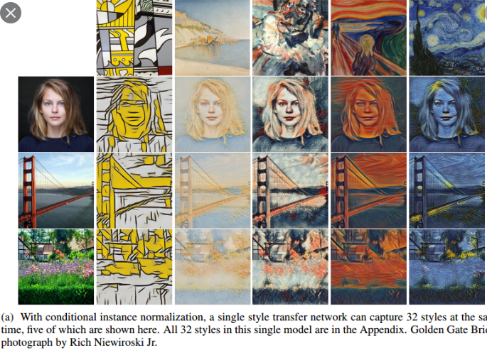
Previous work
Next came the idea that the transformer network could be made to generalize on different styles by choosing optimal sets of normalization parameters(Gamma and beta ) in the feed-forward network. The task was to now also treat the gamma and beta as trainable parameters in the transformer network. This idea was developed by google and is highlighted in this paper A Learned Representation for artistic Style. We could select different normalization parameters to apply different styles to a particular image. We could also selected a linear combination of normalization and create an pastiche image with the this weighted style combination of style. But this technique also was could be used for the styles on which the model was trained and could not generalize to arbitrary styles.

Slide 6
Solution
Next breakthrough came when researchers and Google thought that we could create a style extraction network which would transform the style into a vector representation which could be fed into the style transfer network and allow that model to generalize. Basically they were inspired from the idea of normalization parameters could be found out for each of the style image and could be used into the transformer as a representation of that style and thus we attained the current state-of-art arbitrary style transfer networks which were lightweight and fast. This is highlighted here. Exploring the Structure of an arbitrary real time image stylization network.
Current State of the Network

Slide 7
Solution
The idea was then ported to lightweight models so that it could be used across devices but the core idea remains the same. One of the lightweight application of the above approach is highlighted here Porting the arbitrary style transfer to a Browser. They have used lighter models with less parameters and depth wise separable convolutions instead of convolution layers to significantly reduce the number of parameters in a model.
Reducing the weight of the Model

Slide 8
Implementation
We recommend to run the ipynb notebooks provided to be executed on Google Colab for avoiding compatibility as much as possible.
GIT Link :- https://github.com/parasgoyal12/DIPAAssig3
Note: Please use the above link in google colab to load notebooks directly in colab.

Slide 9
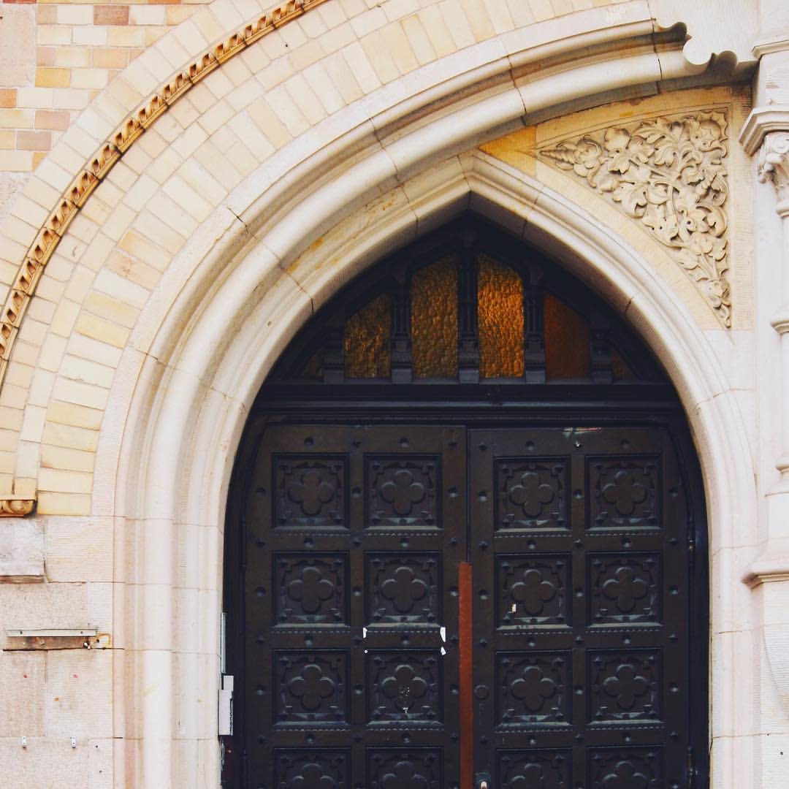
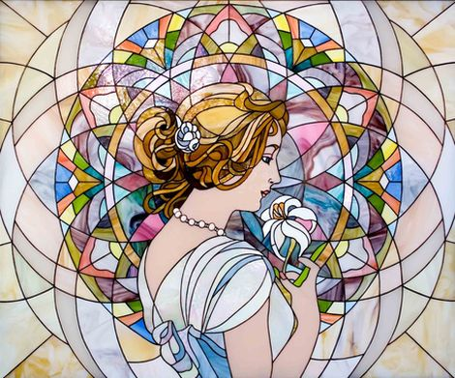
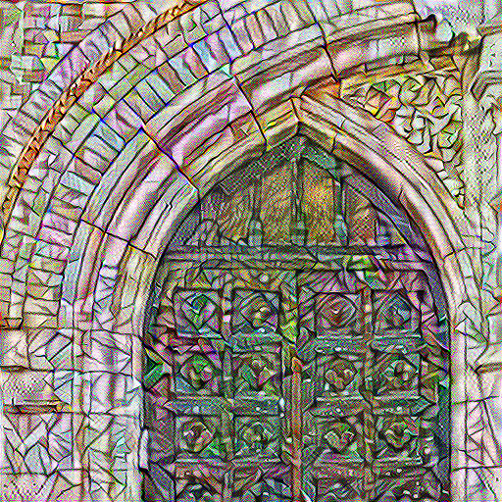
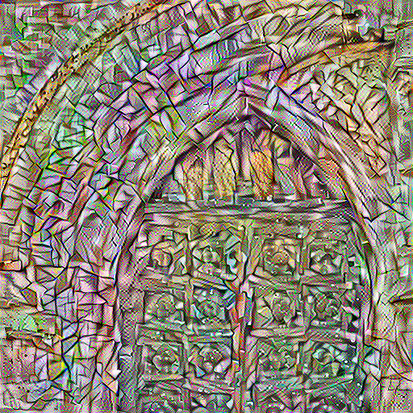
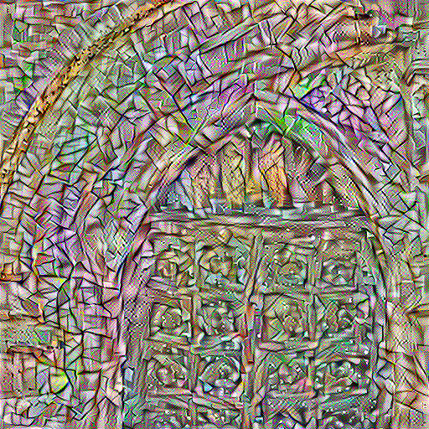
Implementation of A Neural Algorithm for Artistic Style
Output Image (starting with content as base)
Content Image
Style Image
Output Image (starting point as noise)
Output Image (Noise as start and added variation loss)

Slide 10
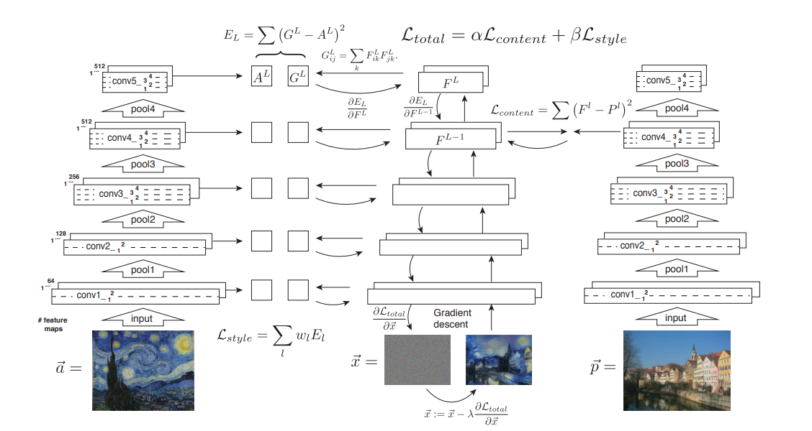
Implementation of A Neural Algorithm for Artistic Style

Slide 11
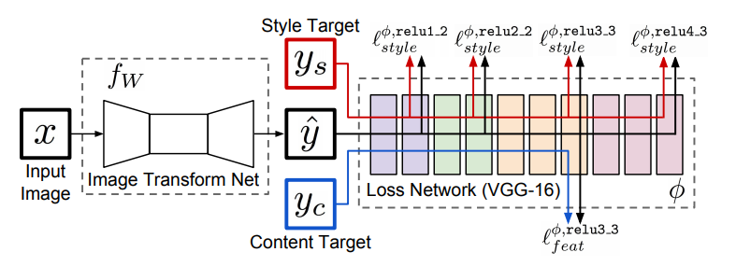
Fast Style Transfer (Johnson et al. 2016)
Style Transform Network (Depicting the training steps with loss calculated using pretrained VGG16). Y-hat is the Stylized Output Image

Slide 12
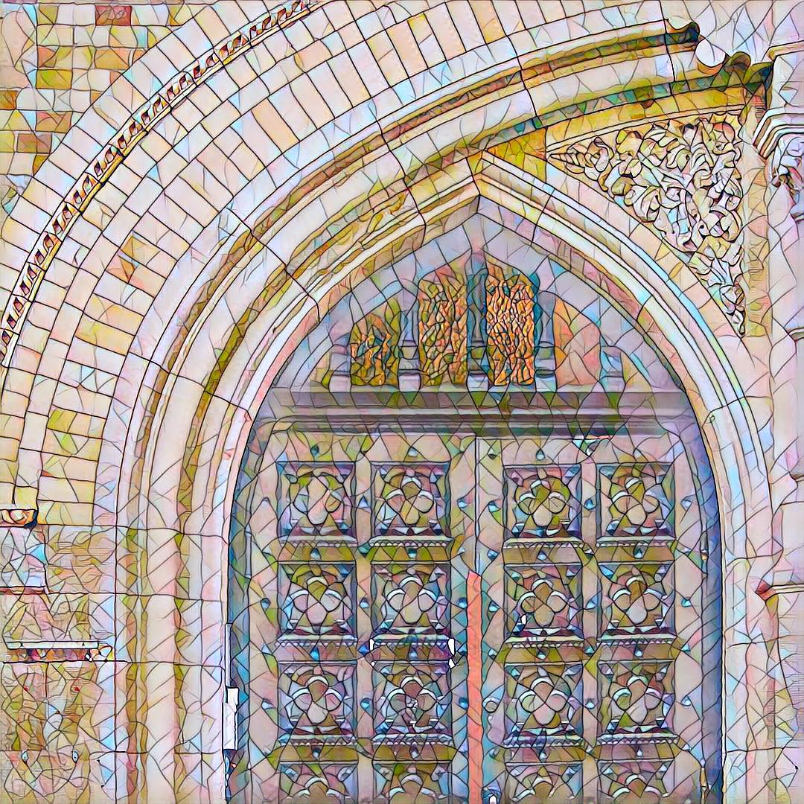
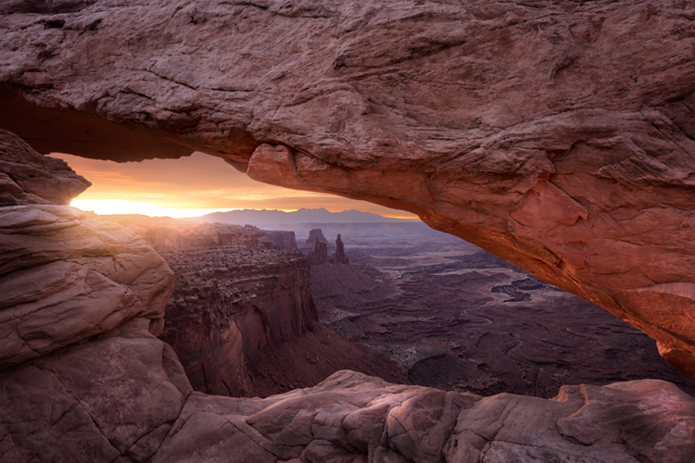
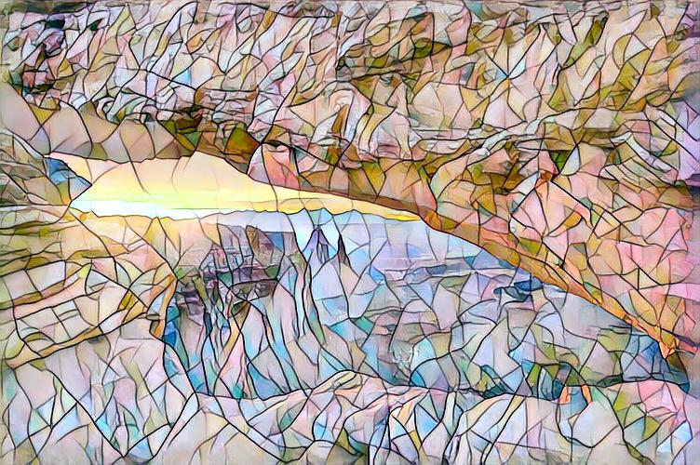
Fast Style Transfer (Johnson et al. 2016)
Model trained on this image as style with different inputs

Slide 13
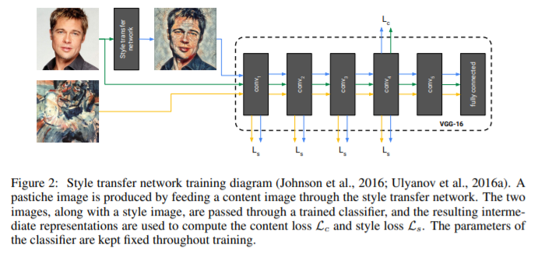
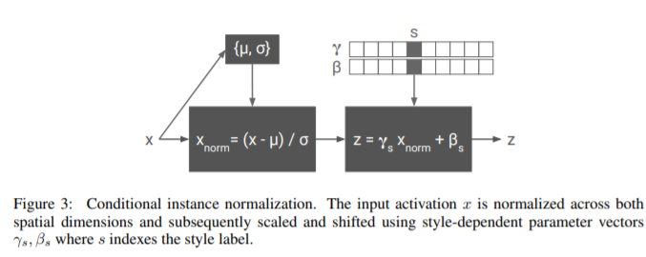
A Learned representation for artistic Style
Live Demonstration and more details available at this link https://magenta.tensorflow.org/2016/11/01/multistyle-pastiche-generator

Slide 14
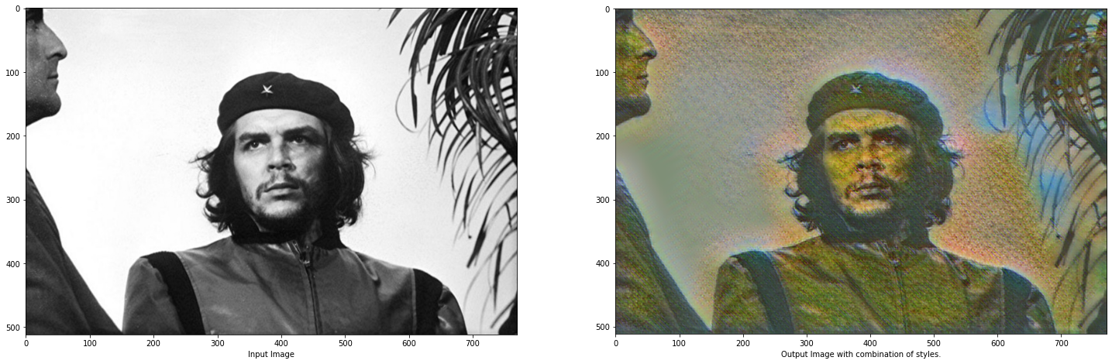
A learned representation for artistic style
Generating the output from a linear combination of 2 or more different styles
Input(left) Output(right) [Generated as a combination of Monet Style 0( wt =0.5) and style 1(wt. =0.5) ]

Slide 15
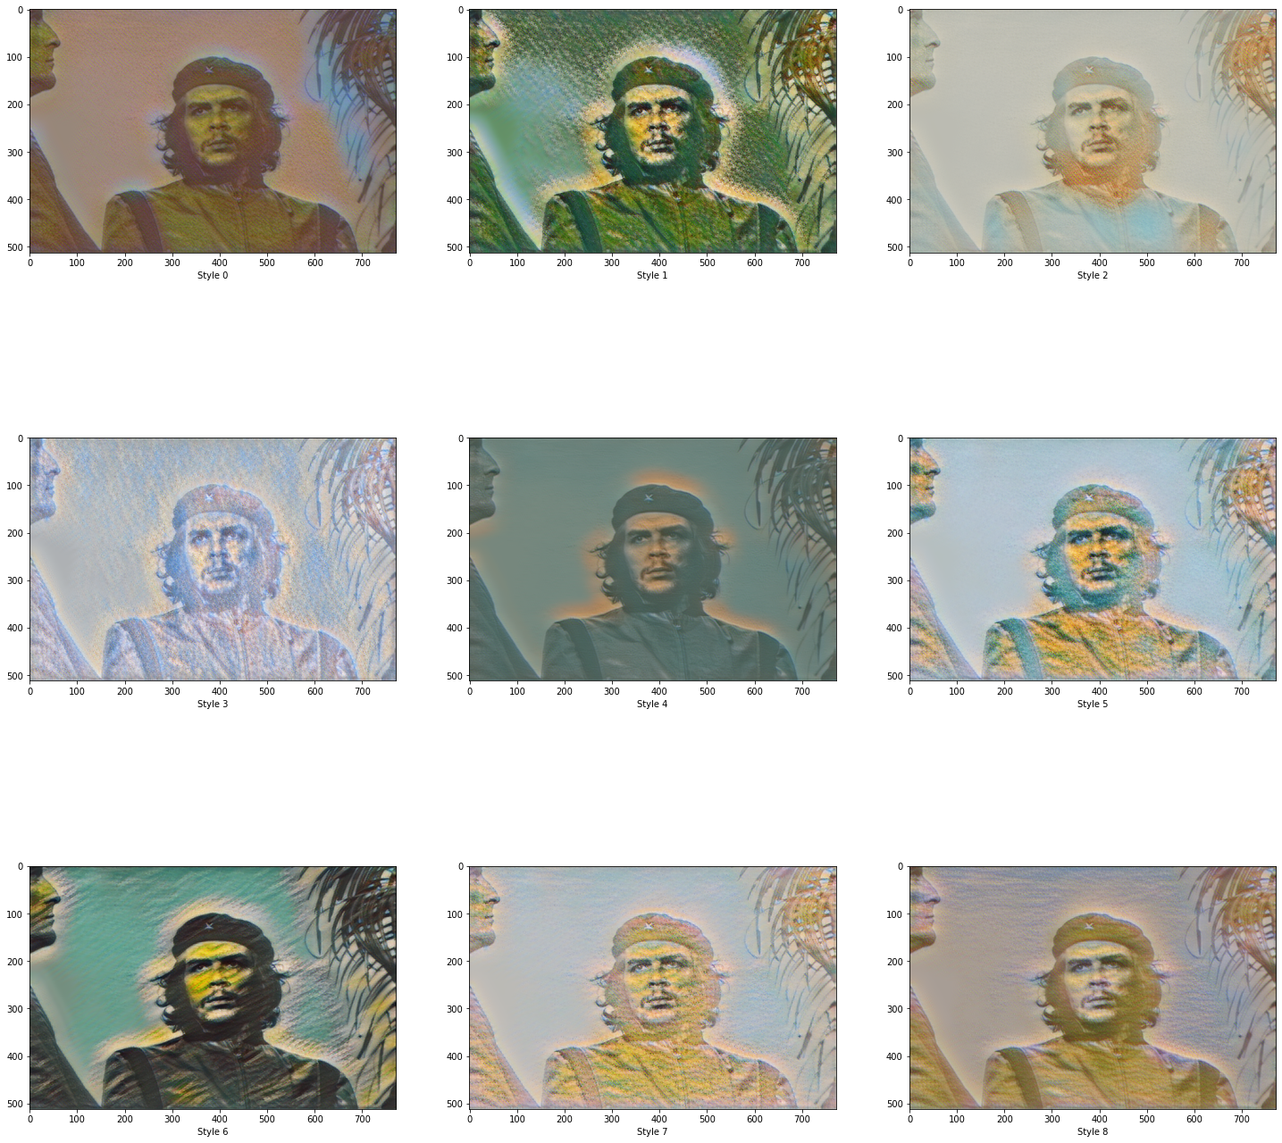
A learned representation for artistic style
Output for each of 9 Monet Style in the following sequence:
Style 0 | Style 1 | Style 2
Style 3 | Style 4 | Style 5
Style 6 | Style 7 | Style 8

Slide 16
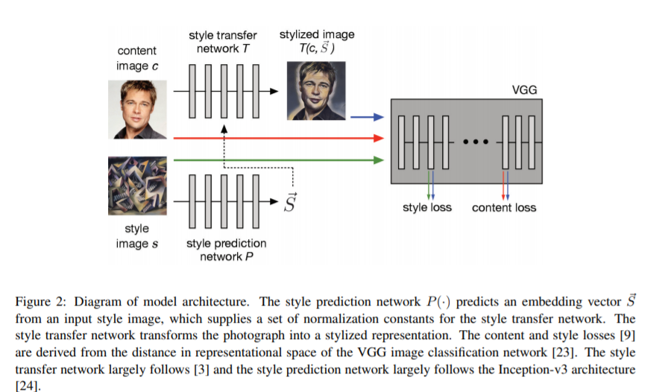
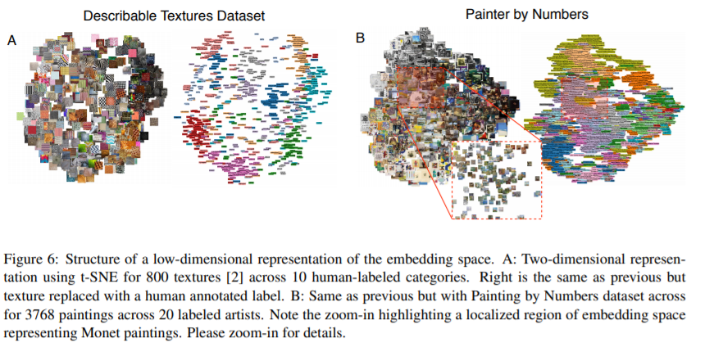
Exploring fast,real-time, arbitrary style transfer

Slide 17
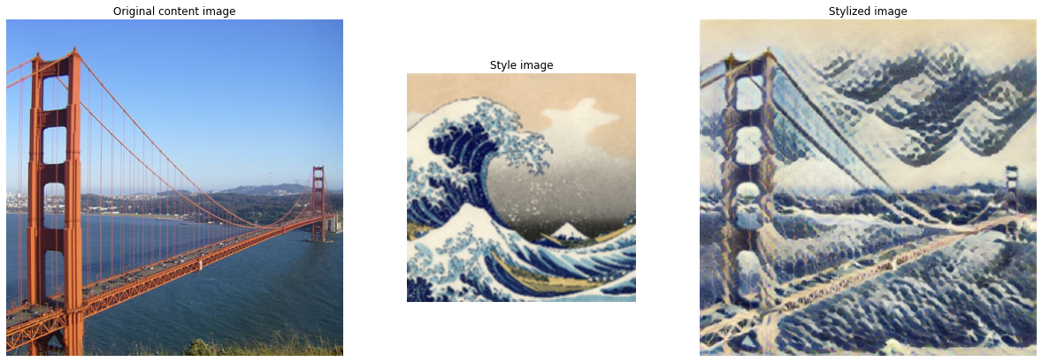
Exploring fast,real time and arbitrary style transfer
Implementation of the model from Tensorflow Hub

Slide 18
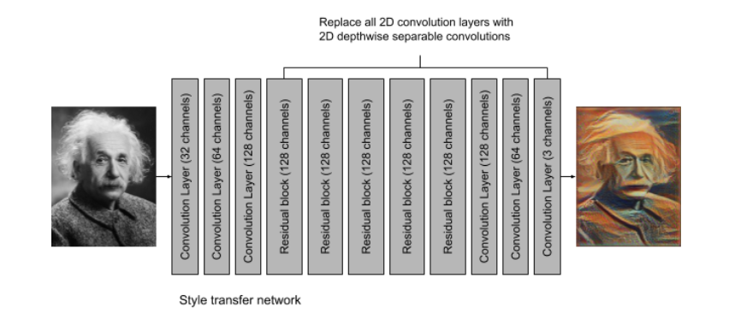
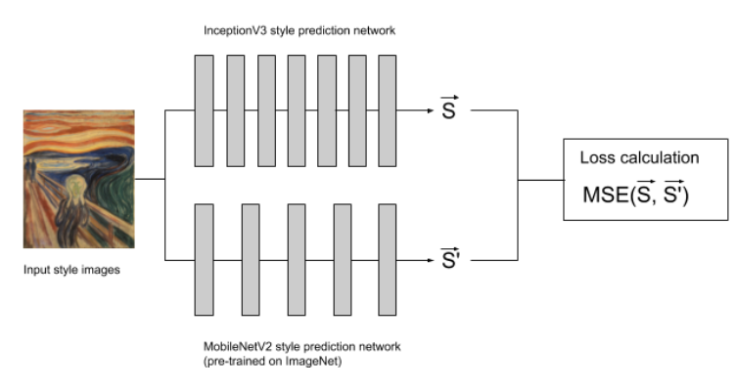
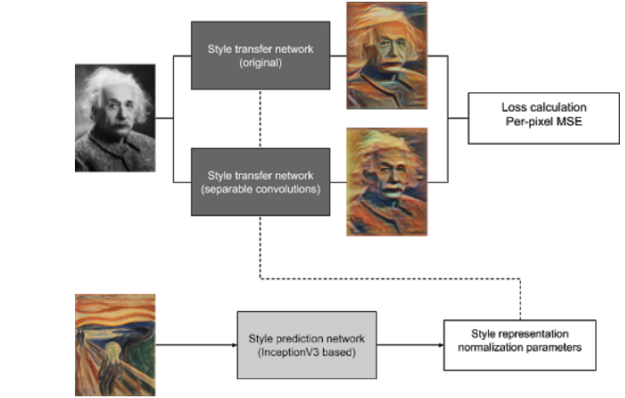
Porting Real time and arbitrary style transfer to browser
Distillation of style Extraction Network
Live Demo:- https://reiinakano.github.io/arbitrary-image-stylization-tfjs
Distillation of Style Transfer Network

Slide 19
Our Learnings
We learned about many of the state of the art architectures and the evolution of solution to a particular problem from the basic insights of a CNN.
We experimented a bit with the implementation of the paper by Gatyes et al (Paper 1) [the first implementation using CNN] by setting the style weight to 0 and seeing on the content being captured and in next part setting content_weight=0 and seeing only the style being filtered out. It is gave us confidence that the method is doing what is supposed to do.
The Paper by Johnson et al (Paper 2) allowed us to learn a lot about Image Transformation Network and the importance of various components of that network.
We learned that accuracy could be compromised upon to gain a significant boost in running time and port the model across devices even without GPUs.
We found a large number of pretrained models in tf-hub which could be used as a starting point to build upon.

Slide 20
References
Neural Style Transfer Using Tensorflow 2.0 https://towardsdatascience.com/neural-style-transfer-23a3fb4c6a9e
Pytorch Examples
https://www.github.com/pytorch/examples
Tensorflow Magenta
https://www.github.com/tensorflow/magenta
Multistyle Pastiche Generator https://magenta.tensorflow.org/2016/11/01/multistyle-pastiche-generator
Arbitrary Style Transfer using Tensorflow.js https://github.com/reiinakano/arbitrary-image-stylization-tfjs

